Slide 1
Enterprise Java Beans
Dr Sumana M

Slide 2
What is Enterprise Java Beans
It is a specification provided by Sun Microsystems to develop secured, robust and scalable distributed applications.
To run EJB application, you need an application server (EJB Container) such as Jboss, Glassfish, Weblogic, Websphere etc. It performs:
life cycle management,
security,
transaction management, and
object pooling.
EJB application is deployed on the server, so it is called server side component also.

Slide 3
When use Enterprise Java Bean?
Application needs Remote Access. In other words, it is distributed.
Application needs to be scalable. EJB applications supports load balancing, clustering and fail-over.
Application needs encapsulated business logic. EJB application is separated from presentation and persistent layer.

Slide 4
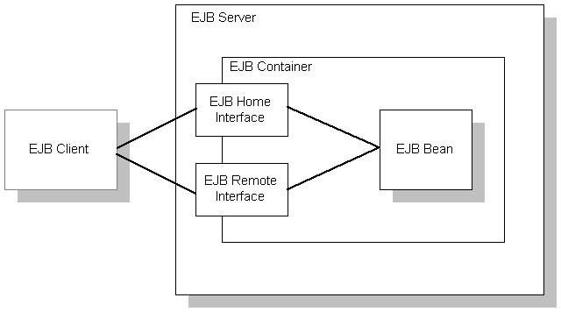
Enterprise Bean Architecture
1. An Enterprise Bean Server
2. Enterprise Bean containers that run on these servers
3. Enterprise Beans that run in these containers
4. Enterprise Bean clients
5. Other systems such as the Java Naming and Directory interface (JNDI) and the Java Transaction Service(JTS).

Slide 5
How does the communication take place
Client object makes a request for a method on the bean.
Container comes into picture and checks whether the client is in the approved list for calling a method on the bean.
If the client is authorized, container either creates new instance or activates the requested bean from the pool.
Container ensures the bean gets its own new transaction
Container informs the EJB object [wrapper class generated by container] that the bean is ready and passes the client’s method request to the bean.

Slide 6
Enterprise Bean Server
EJB server is a component transaction server. It supports the EJB server side component model for developing and deploying distributed enterprise-level applications in a multi-tiered environment.
Enterprise Bean Server provides
A Framework for creating, deploying and managing middle – tier business logic
An environment that allows the execution of applications developed using EJB components.
In a three-tier environment:
Client provides the User Interface logic
The business rules are separated to the middle tier
The database is the information repository

Slide 7
Client does not access the database directly.
Instead, the client makes a call to the EJB server on the middle tier, which them accesses the database.
An EJB server takes care of:
Managing and coordinating the allocation of resources to the applications.
Security
Threads
Connection pooling
Access to a distributed transaction management service.
EJB server provides one or more containers for the enterprise beans, which is called the EJB container.
An EJB container manages the enterprise beans contained within it.
Enterprise beans are reusable modules of code that combine related tasks into a well-defined interface.
These components are installed on an EJB server.

Slide 8
An Enterprise Bean
An Enterprise bean is a server side component that encapsulates the code that fulfils the purpose of the application.
They can be combined with other components and rapidly produce a custom application.
It is not a GUI component and sits behind the GUI and performs all the business logic such as database operations . (rich web based clients and web services )

Slide 9
Types of Enterprise Java Bean
There are 3 types of enterprise bean in java.
Session Bean
Session bean contains business logic that can be invoked by local, remote or webservice client.
Message Driven Bean
Like Session Bean, it contains the business logic but it is invoked by passing message.
Entity Bean
It encapsulates the state that can be persisted in the database. It is deprecated. Now, it is replaced with JPA (Java Persistent API).

Slide 10
Session Bean
Session Bean
Session bean encapsulates business logic only, it can be invoked by local, remote and webservice client.
It can be used for calculations, database access etc.
The life cycle of session bean is maintained by the application server (EJB Container).
It is a short-lived object that executes on behalf of a single client.
It is a temporary, logical extension of a client application that runs on the Application Server.

Slide 11
Session beans:
Execute for a single client
Can be transaction aware.
Do not represent directly shared data in n underlying database, although they may access and update this data.
Are short-lived.
Are not persistent in a database.
Are removed if the container crashes and the client has to establish a new session.
May be stateless and stateful

Slide 12
Types of Session Bean
There are 3 types of session bean.
1) Stateless Session Bean: It doesn't maintain state of a client between multiple method calls.
2) Stateful Session Bean: It maintains state of a client across multiple requests.
3) Singleton Session Bean: One instance per application, it is shared between clients and supports concurrent access.

Slide 13
Stateless Session Bean
Stateless Session bean is a business object that represents business logic only. It doesn't have state (data).
Do not remember anything about the client between the calls of the method.
Forgets the client once the business process completes or executes.
In other words, conversational state between multiple method calls is not maintained by the container in case of stateless session bean.
Bean types are lightweight and provide a high degree of scalability.
No client state maintained , hence can be used across multiple clients.
The stateless bean objects are pooled by the EJB container to service the request on demand.
It can be accessed by one client at a time. In case of concurrent access, EJB container routes each request to different instance.
A stateless session bean can implement a webservice, where other types of enterprise beans cannot.

Slide 14
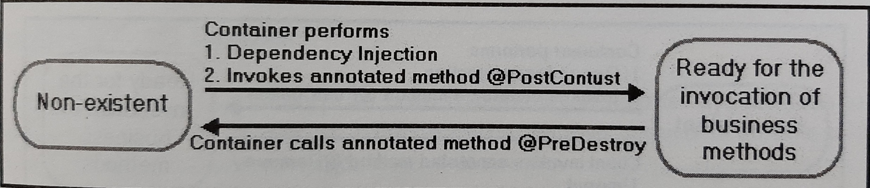
There is only two states of stateless session bean: does not exist and ready.
The client initiates the life cycle by obtaining a reference to a stateless session bean.
EJB Container creates and maintains a pool of session bean first. It injects the dependency if then calls the @PostConstruct method if any.
Bean is now ready to have its business methods invoked by the client.
At the end of the lifecycle, the EJB container calls @PreDestroy method if any. Now bean is ready for garbage collection.

Slide 15
Stateful Session Bean
Remembers conversions between the client of the application and the application itself across method calls.
Stores data that is client specific.
Client calls the method again the bean remembers the clients previous method call.
Client initiates the life cycle by obtaining a reference toa stateful session bean.
The container performs dependency injections and then invokes the method named @PostContruct, if it exists.
Bean is now ready to have its business methods invoked by the client.

Slide 16
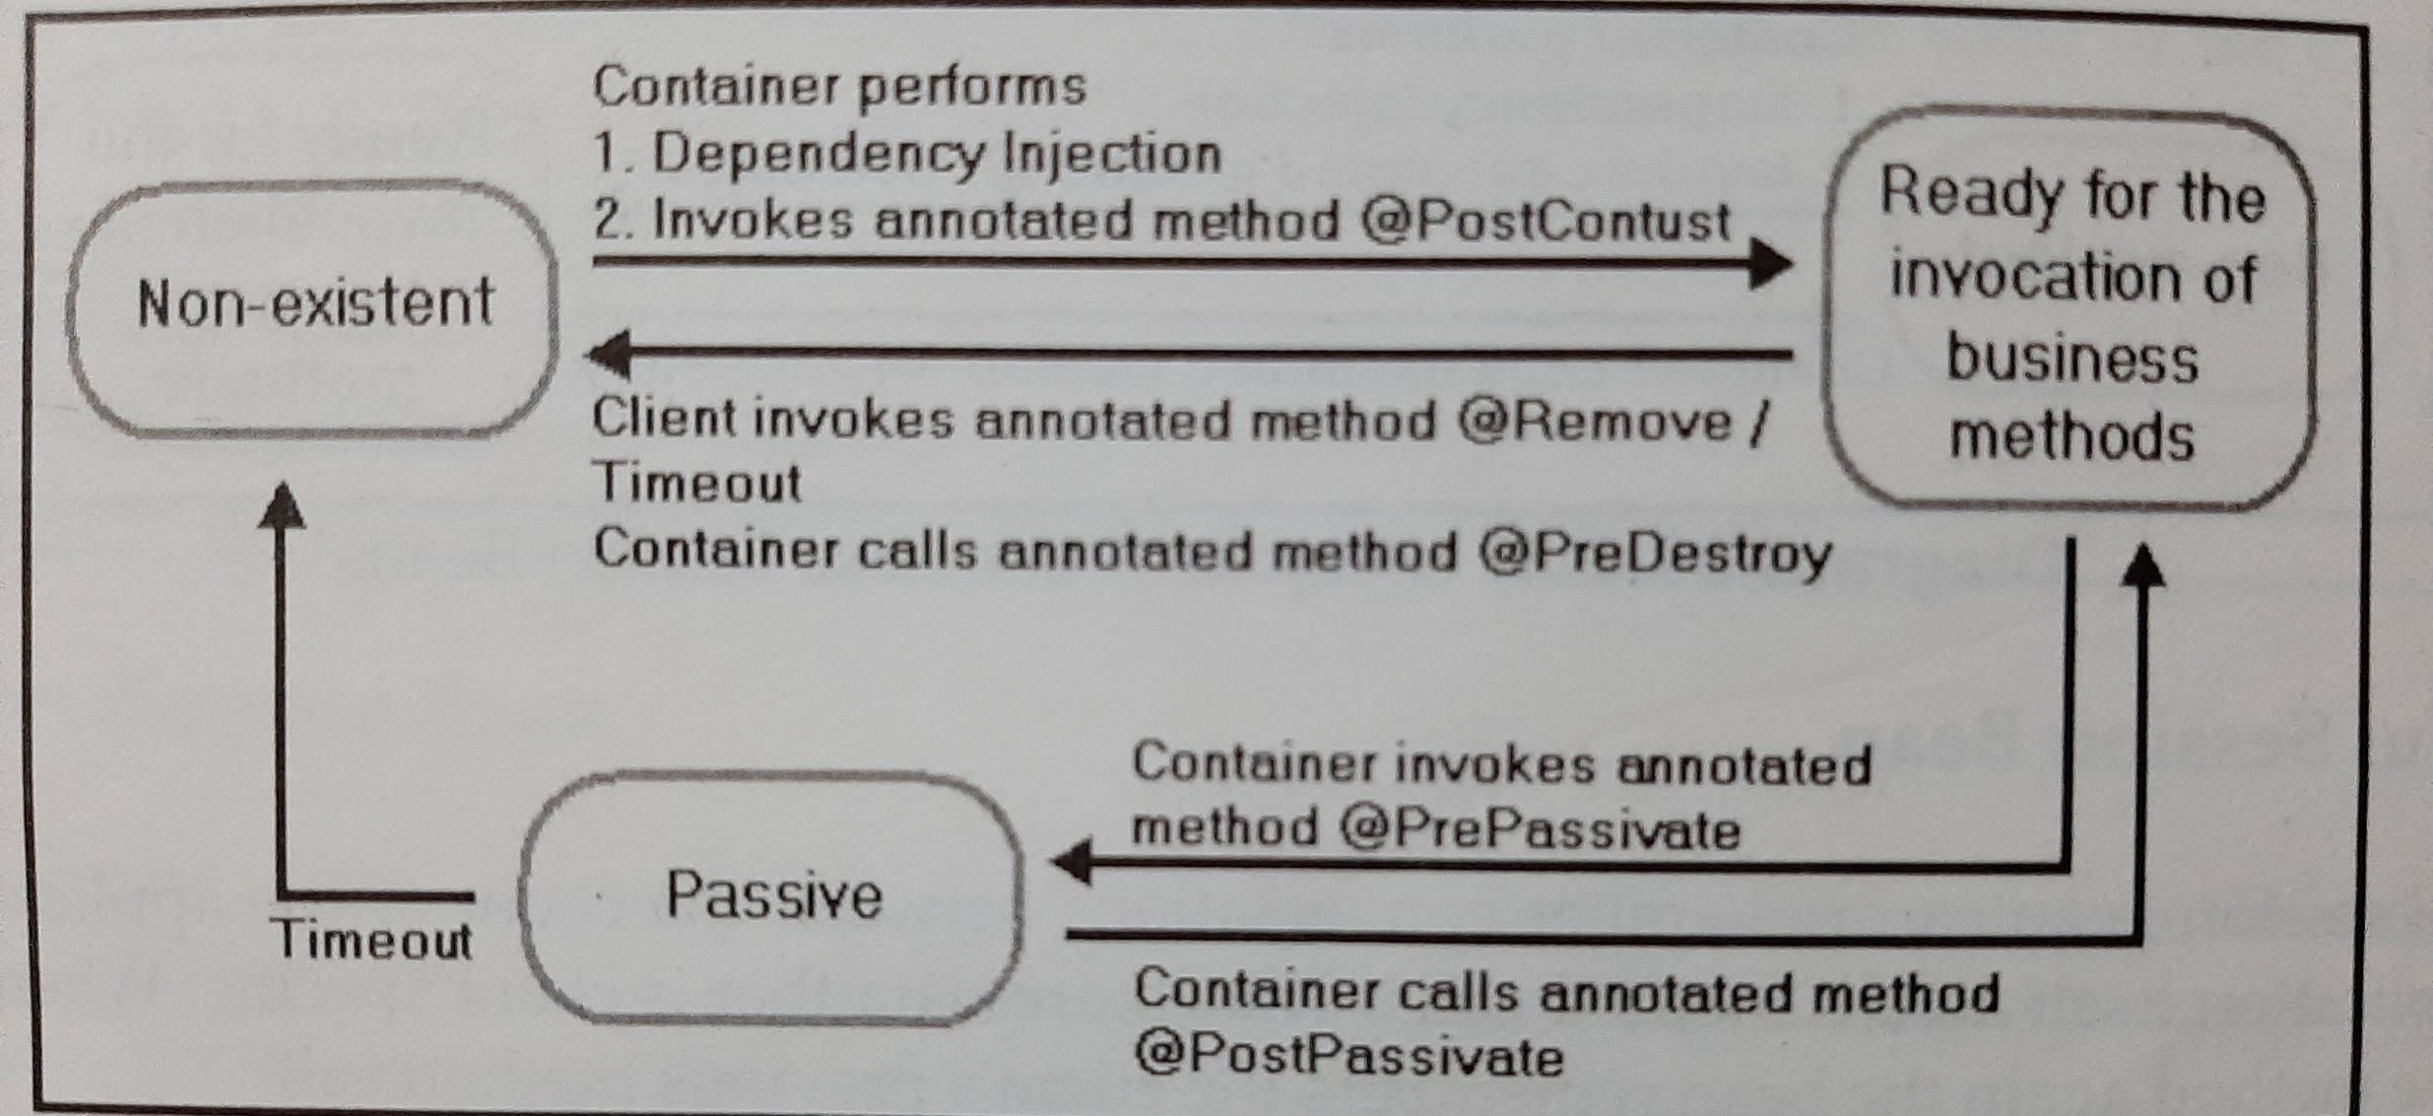
Stateful Session Bean

Slide 17
Entity Beans
Represents data maintained by an enterprise, typically in a database.
there was two types of entity beans: bean managed persistence (BMP) and container managed persistence (CMP).
Bean – managed persistence, more control is given to the EJB developer to save and retrieve data, which is harder to build, as more coding is required.
Container-managed persistence, container is responsible for saving and retrieving the data from the underlying database.

Slide 18
Message Driven beans
Enterprise bean that allows enterprise applications to process messages asynchronously.
Similar to an event listener except that it receives messages instead of events.
Messages may be sent by any component, an application client, another enterprise bean or a web component, or system at does not use Java EE technology.
Message Driven Beans:
Do not have home or component interfaces.
Do not have business methods but define a message listener method, which the EJB container invokes to deliver messages
Do not hold any state between calls of the message listener method.
Are relatively short lived
Do not represent directly shared data in the database, but they can access and update this data.
Can be transaction aware.

Slide 19
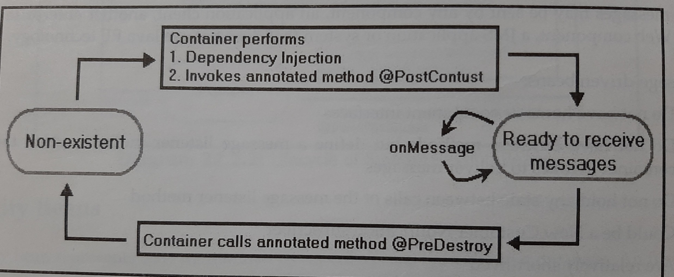
Life cycle of the Message Driven Bean

Slide 20
Benefits of Enterprise Bean
Complete focus only on business logic
Reusable components
Portable – across multiple platforms ( write once deploy anywhere)
Fast building of Applications
One Business logic having many presentations
Distributed Deployment
Application Interoperability
Customized Deployment

Slide 21
Disadvantages of EJB
Requires application server
Requires only java client. For other language client, you need to go for webservice.
Complex to understand and develop ejb applications.

